Slide 1
Project Office Progress Champika GALLAGE DBCP Coordinator/ OceanSITES Project Office cgallage@jcommops.org OceanSITES 2016 11th Steering Committee and 8th Data Management Team Meeting
National Oceanography Centre, Southampton, United Kingdom 25 - 29 April 2016

Slide 2
Outline
OceanSITES within WMO/IOC
JCOMMOPS and Project Office
Project Office Activities
Progress on Project Office Activities
OceanSITES Budget overview

Slide 3
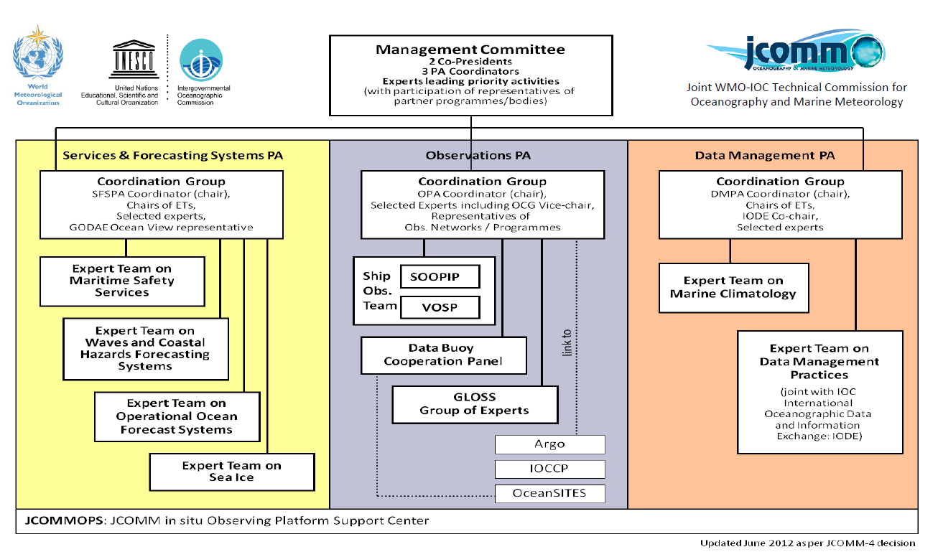
Project Office - JCOMMOPS
JCOMMOPS
Notes:
I would like to start with a very quick review on where OceanSITES sits in the bigger organization of IOC and WMO. We are part of JCOMM
which is the Joint WMO-IOC Technical Commission for Oceanography and Marine Meteorology . This an intergovernmental body of technical experts that provides a mechanism for international coordination to the meteorological and oceanographic communities.
All the observation programs are coordinated under the Observation Coordination Group in the middle.
OceanSites
Data buoy cooperation panel
ARGO program
Ship observing team
All these are coordinated under one entity called JCOMMOPS which is the Jcomm in-situ observations Program Support Center

Slide 4
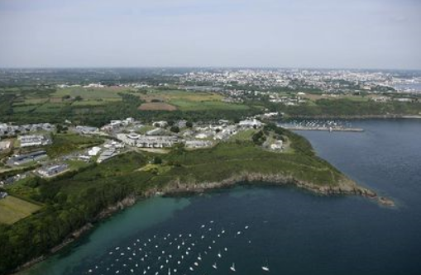
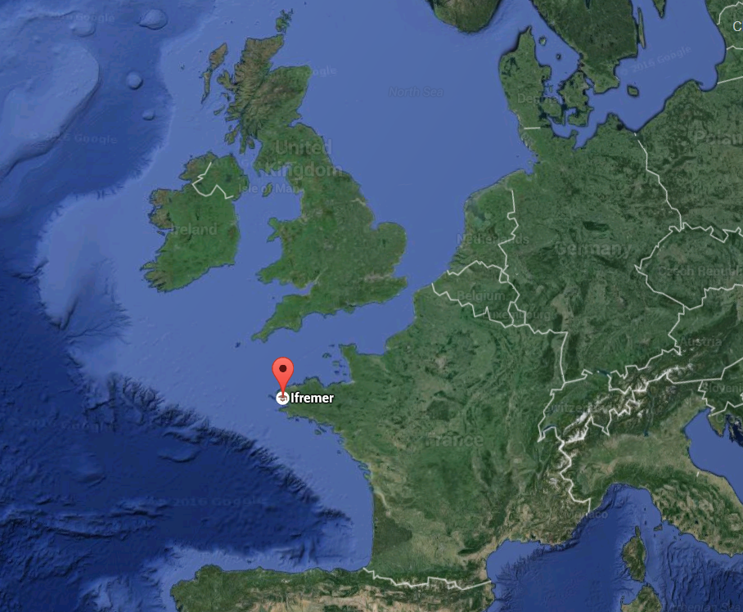
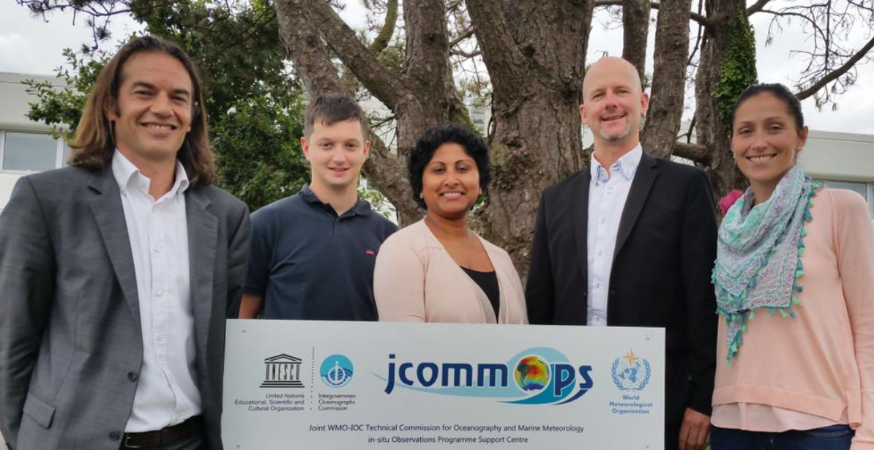
JCOMMOPS/OceanSITES Project Office
Office co-located in IFREMER, Brest, France
Total of six full time staff
Technical Coordinator ,DBCP/OceanSITES
Technical Coordinator, ARGO
Technical Coordinator, SOT
IT Engineer,
Coordinator, for science & communication,
Web developer (contract ending Jun 2016)

Slide 5
Project Office Activities
1/3 of the TC time is for OceanSITES activities:
Assist in the planning, implementation and operations of the OceanSITES network
obtain and continually update information about the sites
maintain technical documentation
update the JCOMMOPS database and maps
maintain member contact information
maintain OceanSITES website
assist with emerging needs
Monitor, communicate and resolve action items
action items from previous OceanSITES 2014 meeting
action items from EC and DMT monthly meetings
Organize meetings, take notes, prepare meeting reports
monthly meetings for EC and DMT groups
Regular meetings with co-chairs
Notes:
Assist in the planning, implementation and operations of the OceanSITES network in close consultation with the Chairs, Executive Committee, Steering Committee, and Data Management Team by:
obtaining and continually updating information about the sites;
maintaining technical documentation;
3) updating the JCOMMOPS database and maps, there was quite a lot of work done on JCOMMOPS new website to intigrate OCeanSITES information in to the new JCOMMOPS web tool.
4) Maintain contact information for OceanSITES members
5) Maintain OceanSITES website. There are many updates to the website . I will go through them in the later part of this presentation.
5) providing other information based on emerging needs, findings and discussions of the OceanSITES community
Monitor, communicate and resolve all action items as identified during OceanSITES sessions and report on resolved/ongoing/outstanding action items at before, during, and after meetings
You all must have received many emails from me asking for updates to the
action items from previous OceanSITES 2014 meeting
action items from EC and DMT monthly meetings
I also organize meetings, for EC and DMT, take notes, prepare meeting reports
We had 12 EC meeting during past one and half years and similar number of DMT meetings.
I have Regular meetings with co-chairs to discuss the work plans and progress of the work.
Time to time I have ad hock meetings with other OceanSITES memebrs to discuss the progress of work.

Slide 6
Project Office Activities (continued)
1/3 of the TC time is for OceanSITES activities:
Serve as a representative of OceanSITES, as directed, at relevant technical or scientific meetings, and prepare OceanSITES input (reports, presentations) for such meetings
EGU in 20105
Ocean Sciences 2016
Assist members of OceanSITES by providing technical advice
Perform administrative duties and support to the Committees and Teams as required
Assist with ensuring timely submission of data to the GDACs
VIII. Support and promote initiatives to improve international dialogue, both online and offline, between national and international communities of OceanSITES
Pacific Island Capacity building workshop, Palau, 2015
North Pacific Ocean and Marginal Seas (NPOMS-4), South Korea 2015
Notes:
Serve as a representative of OceanSITES, as directed, at relevant technical or scientific meetings, and prepare OceanSITES input (reports, presentations) for such meetings
EGU in 20105
Ocean Sciences 2016
Assist members of OceanSITES by providing technical advice. Most of the time this type of information is requested by prospective members
Perform administrative duties and support to the Committees and Teams as required.
In collaboration with the Executive Committee, assist with ensuring timely submission of data to the GDACs.
VIII. I try to promoteOceanSITES activities in national and international communities. Last year there were two capacity building workshops where I presented the activities of OceanSITES
Pacific Island Capacity building workshop, Palau, 2015
North Pacific Ocean and Marginal Seas (NPOMS-4), KIOS, South Korea 2015

Slide 7
Documents
Steering Committee :
Mission Statement
Benefits of joining the network
Organization and Governance
Goals and Objectives of OceanSITES
What is OceanSITES
How to become an OceanSITES
Performance metrics
Data Management Team:
OceanSITES Data Format Reference Manual (formerly User's Guide)
OceanSITES Data Providers' Guide
OceanSITES Data Users' Guide ???
Notes:
Here I have listed all the documents you started to work on during 2014 Recife meeting and the current status of those documents. Out of 7 five documents are finalized and posted on the website. One documents in yellow has finalized but I am waiting for the final version to post it on the website. Performance indicators for OceanSITSE need to be developed. I assume that we will be able to setup couple of performance indicators by the end of thes meeting.

Slide 8
New Items on Website
Home page: News items and posters
Notes:
These slides show the improvements done to the website. On the homepage lefthans section you have key new items added to the website.

Slide 9
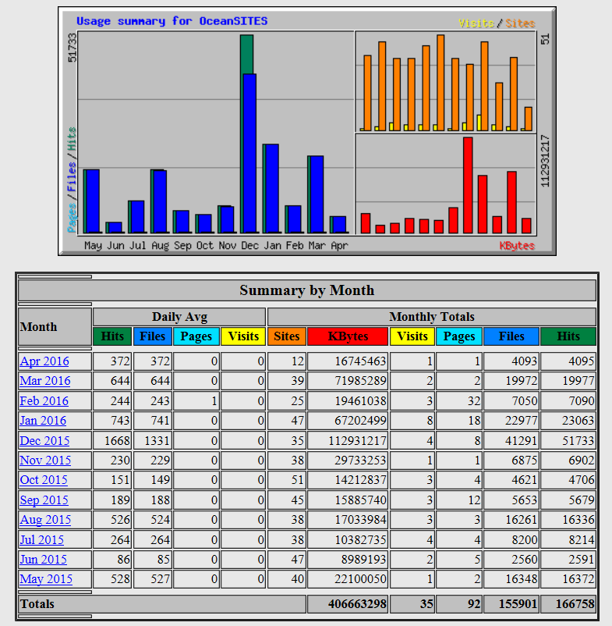
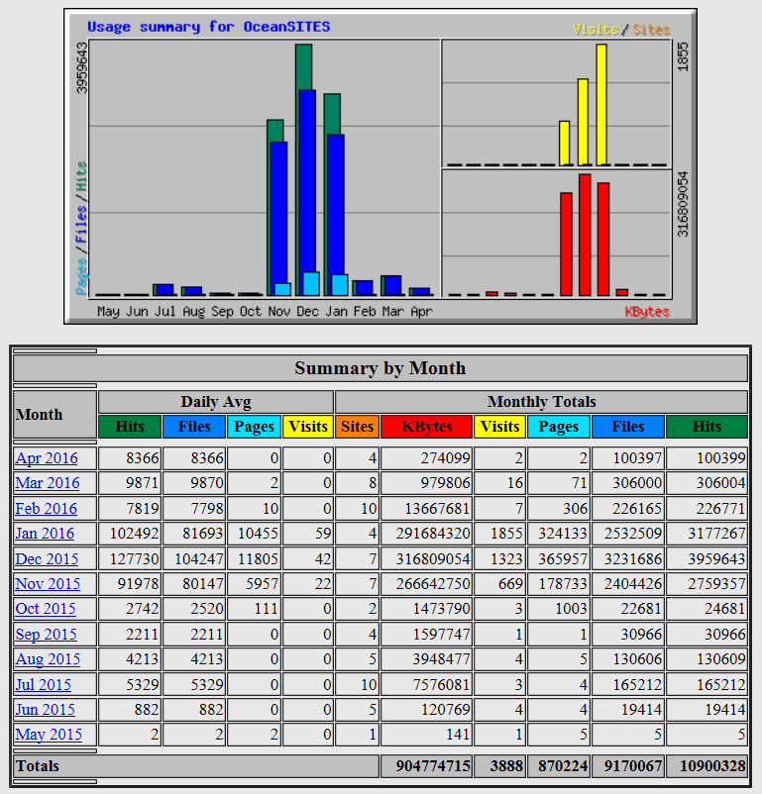
New Items on Website
About: FTP and THREDDS usage statistics link to NDBC http://dods.ndbc.noaa.gov/stats/ftp/
http://dods.ndbc.noaa.gov/stats/oceansites/
Notes:
On ABOUT section you can find the links to the information on FTP and THREDDS usage statistics developed by NDBC (by Karen and Jing)

Slide 10
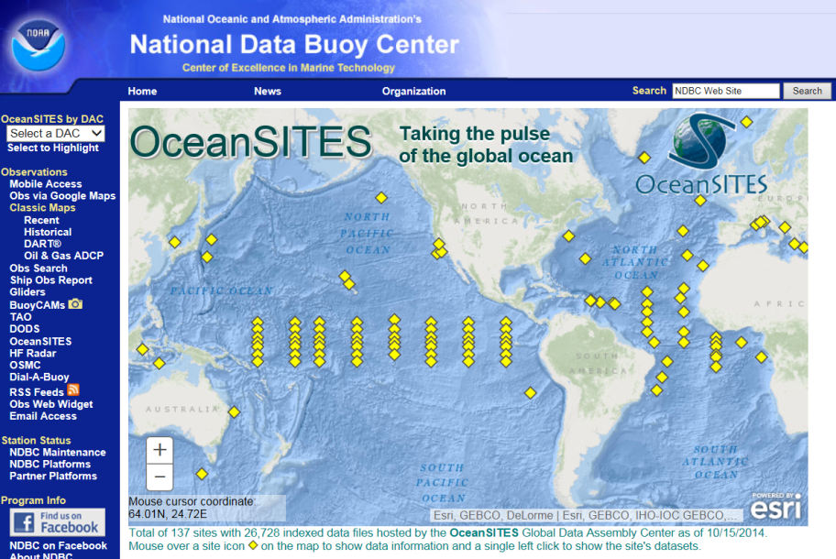
New Items on Website
Data: Format checker link to Coriolis
http://www.coriolis.eu.org/Data-Products/Tools
New NDBC OceanSITES web-link
http://dods.ndbc.noaa.gov/oceansites/
Notes:
Under the Data section, I have added data Format checker made available through CORIOLIS.
You also can see the new NDBC site link under the data flow section

Slide 11
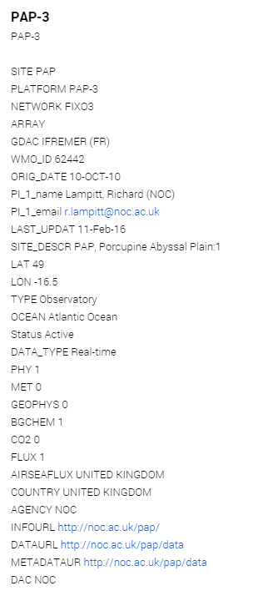
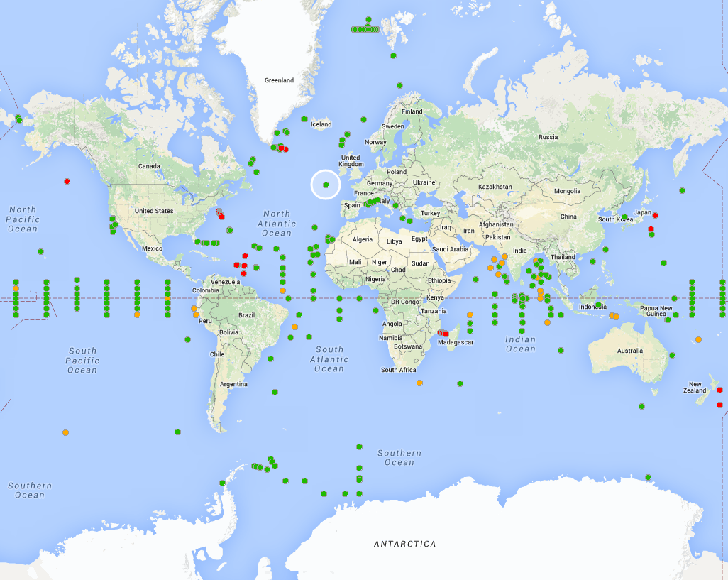
New Items on Website
Maps: Site information available on hover over the points. Link to new Website for interactive map views
Notes:
Map section is updated with a new latest google map application where you can have the station information when you hover over the platform location.

Slide 12
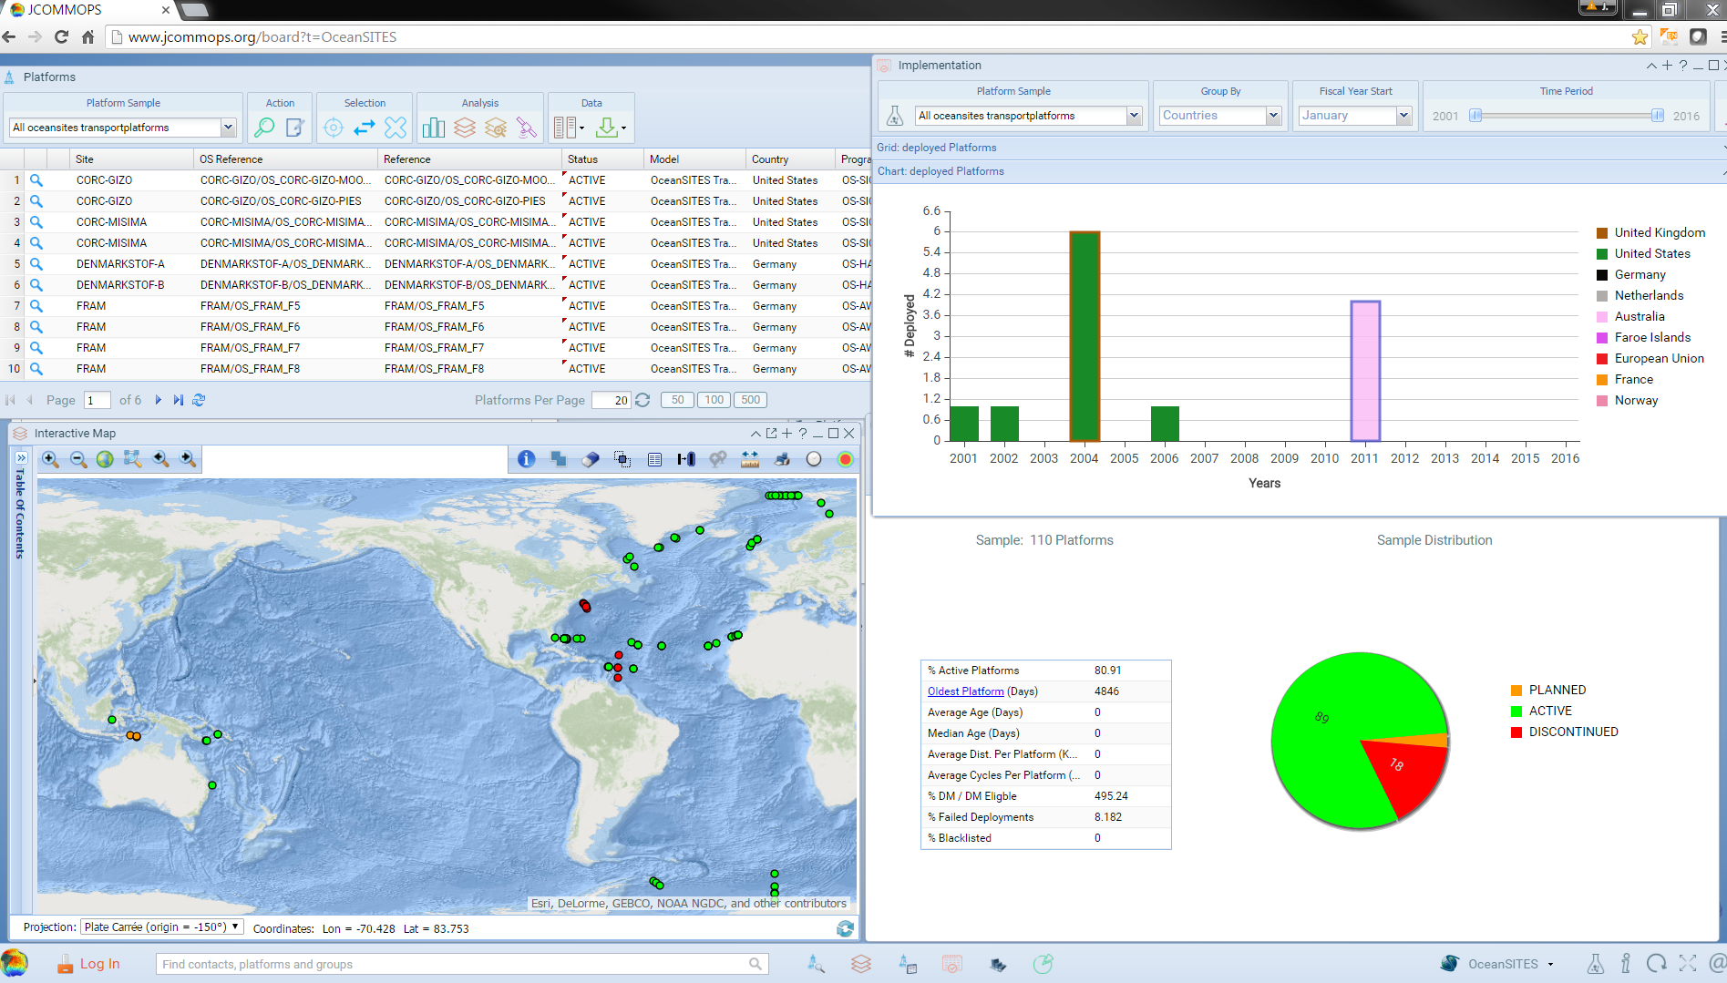
New JCOMMOPS web application
Notes:
This is a snapshot of JCOMMOPS new web application which is an interactive tool to find the information you need on the platforms which are coordinated through JCOMMOPS program. We will do a live demo of the new website on Thursday during OceanSITES website presentation.
Our IT person Anthonin Liz will join us to present the website and to gather your requirements to improve the tool to serve your needs.
You may have heard about the WMO WIGOS framework. JCOMMOPS prove the metadata information for all the platforms which are coordinated through JCOMMOPS. Therefore it is very important
WMO Integrated Global Observing System (WIGOS) framework is an interdisciplinary exercise seeking the integration of in-situ and space based ocean observing systems.

Slide 13
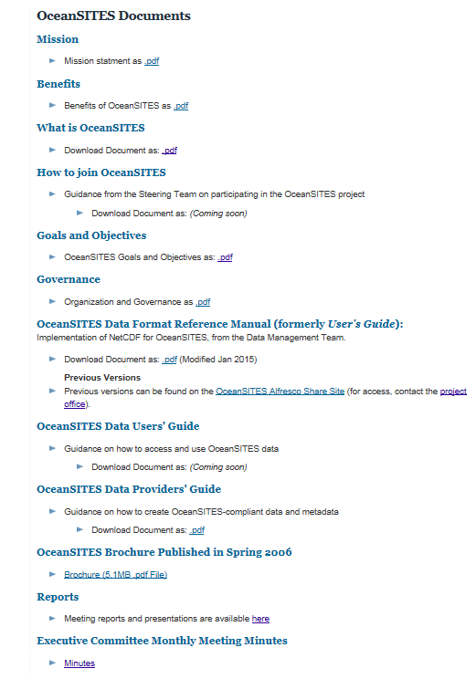
New Items on Website
Documents:
Mission Statement
Benefits
What is OceanSITES
Goals and Objectives
Governance
Data format reference manual (updated)
New !
EC meeting minutes are available only for OceanSITES Members in a password protected section.
Notes:
Under the Document section you can find all the finalized documents
Mission Statement
Benefits
What is OceanSITES
Goals and Objectives
Governance
Data format reference manual (updated)
Executive Committee recently decided to make the EC monthly meeting minutes available to the OceanSITES community. This has passward protected access to the documents. I have finished settingup everything except one meeting note which has not reviewed by any of the Executive members . Once I can get the approval on that document I will send the access credentials to all OceanSITES members.

Slide 14
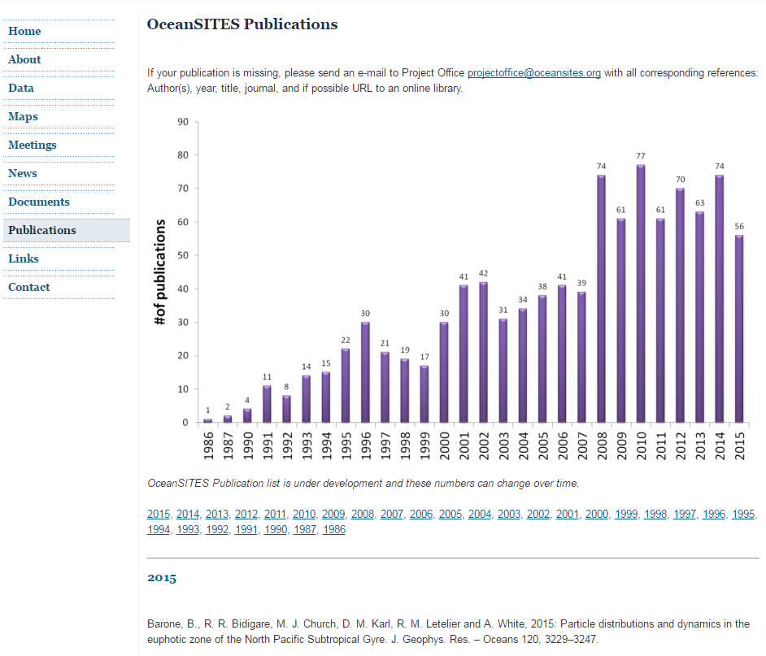
New Items on Website
New !
Publications section added to the website.
Notes:
Final Item I worked on and put so much of my time into is the Publications section of the website. I received a very good response rate for this request and many of you have submitted your publications. The total number I received exceeded 990. All I have received is included here. I will talk more about this tomorrow during Bibliography talk.
The next couple of slides are on the OceanSITES Budget and, Emanuela who is the Science and Communications coordinator for JCOMMOPS takes care of the Jcommops Budget and she will give you an overview of the budget.

Slide 15
JCOMMOPS Budget
JCOMMOPS overall yearly budget: 818k$ in 2015 (2/3 for staff)
Provided by ~20 Member States/Countries (via IOC , WMO & CLS)
Bretagne/Finistère/Brest (public money= 100k€/year for 3 years)
European Union (Seadatanet, AtlantOS)
Specific services to be developed
Ship Time Service
Partnerships with civil society
Contributions 2015

Slide 16
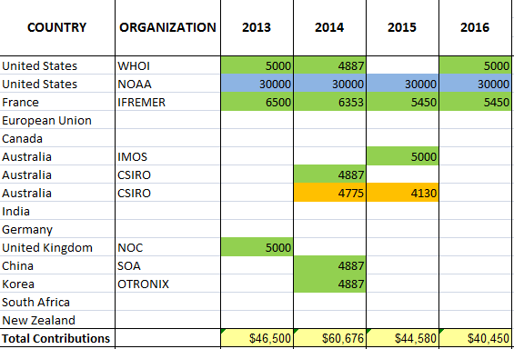
Donations for OceanSITES
Donations by country to the OceanSITES programme are distributed over three Funds:
CLS | WMO DBCP Trust | WMO JCOMM Trust
2013
2014
2015
on-going

Slide 17
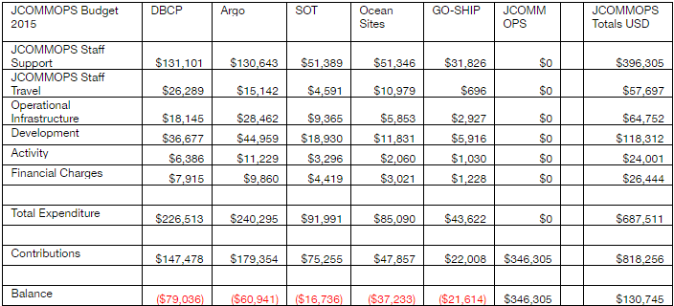
OceanSITES Expenditures 2015

Slide 18
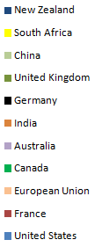
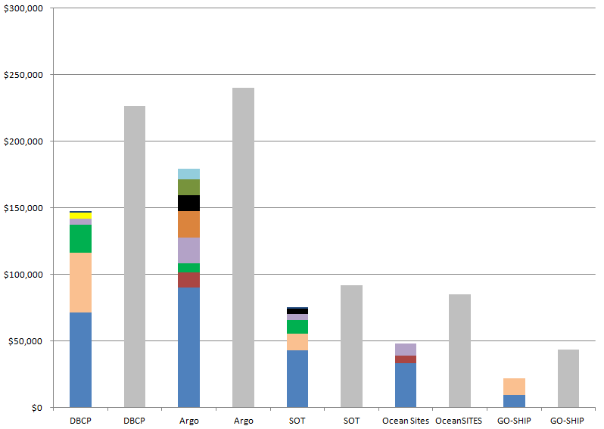
Contributions & Expenditures 2015
The bar chart compares contributions by programme with the JCOMMOPS expenditures made on behalf of the programmes.
In most cases expenditures exceed contributions, the difference is made up by donations to JCOMMOPS as a whole.
Contributions & Expenditures:
Contributions to JCOMMOPS
Programmes
The majority of these donations come from France for support of the JCOMMOPS staff and facilities at Brest (~ 250k$).
The value received by programmes is greatly enhanced by the synergy of sharing resources:
the programmes received more services from JCOMMOPS than they “paid for”.

Slide 19
Summary
Notify Project Office on changes to the Stations/platforms
Submit updated white papers on site information to Project Office
Follow DMT guidelines when submitting data to the GDACs
Timely response to emails/requests from Project Office
Thank You !

